Slide 1

Advanced topics Thomas Künneth
https://unsplash.com/photos/27LH_0jXKYI

Slide 2
Let‘s recap
Two main types of visual composable functions
Traditional UI elements
Layouts
In Compose it is ok to nest layouts

Slide 3
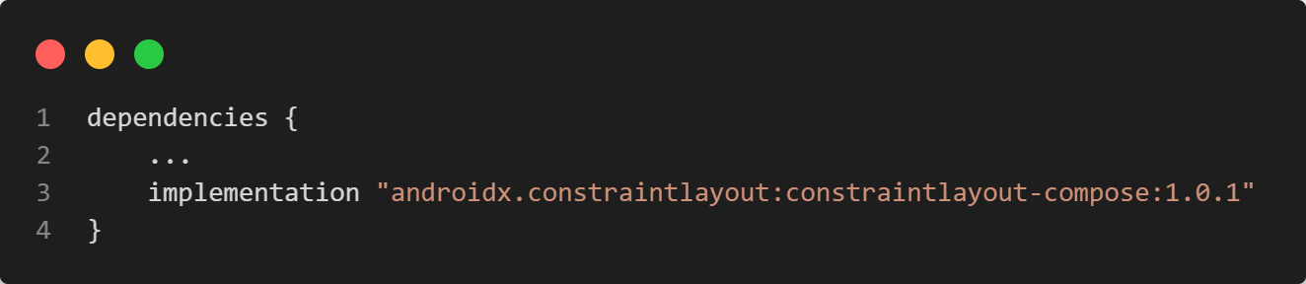
Constraint-based layouts
ConstraintLayout() lays out children based on constraints
Uses references created with createRefs() of a ConstraintLayoutScope
Children are constrained with the constrainAs { ... } modifier

Slide 4
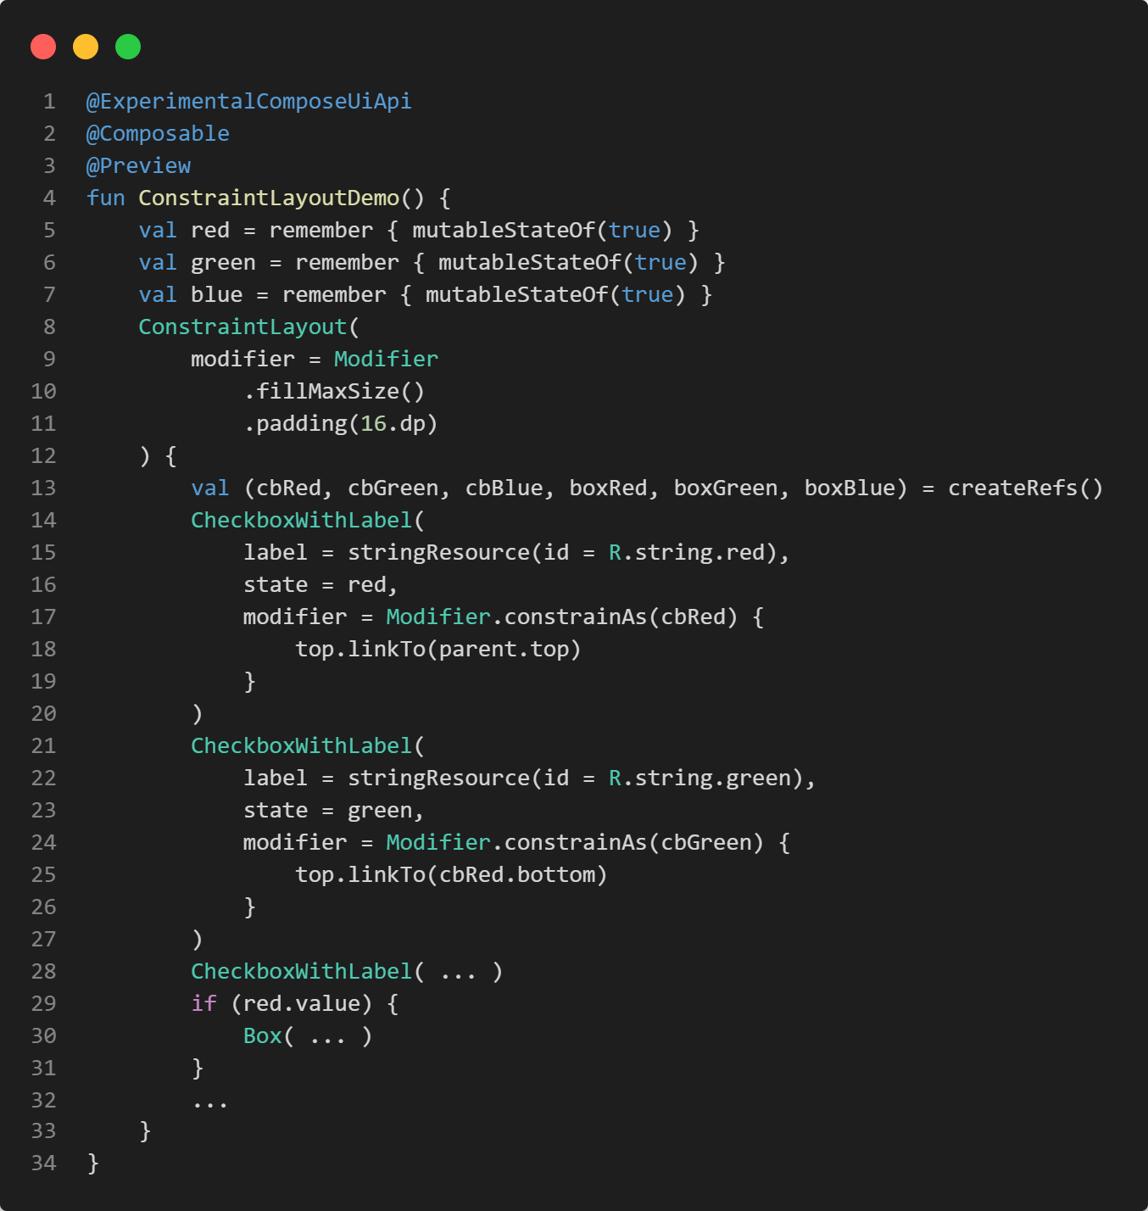
ConstraintLayoutDemo

Slide 5
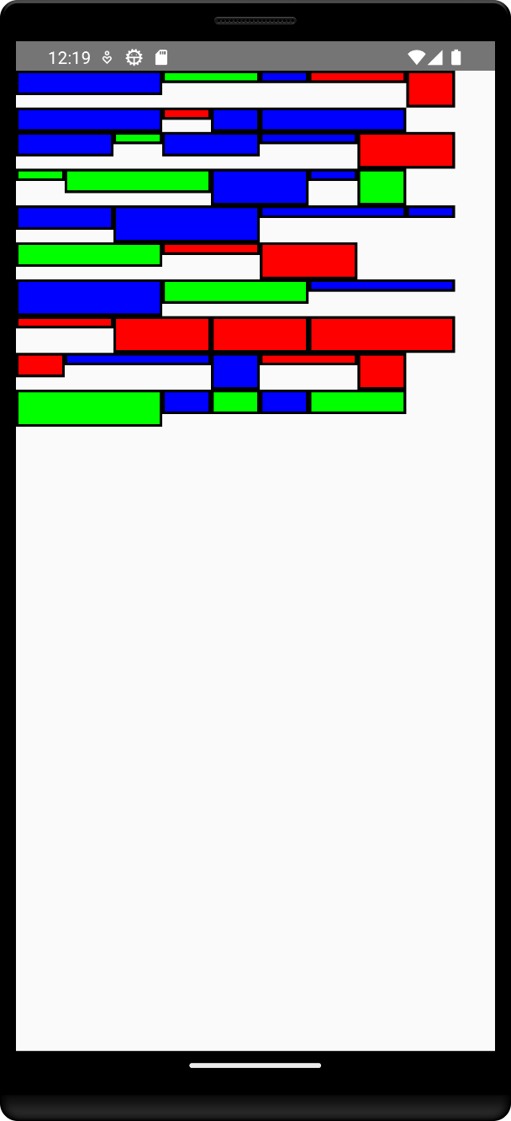
CustomLayoutDemo

Slide 6
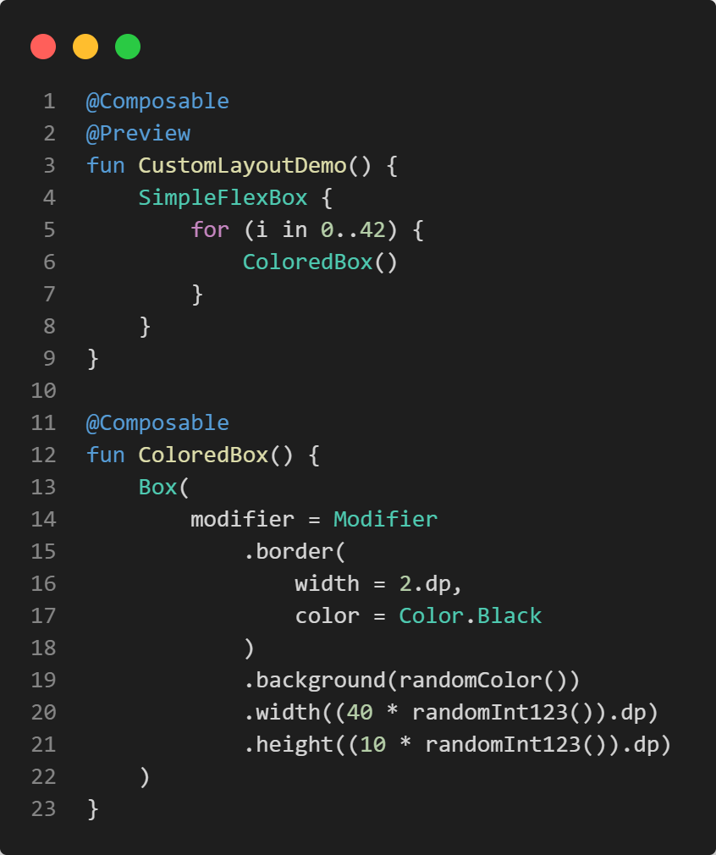
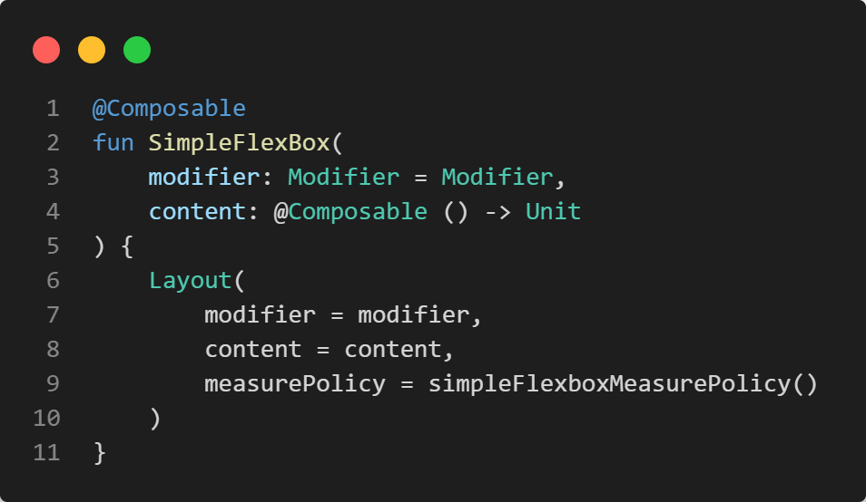

Slide 7
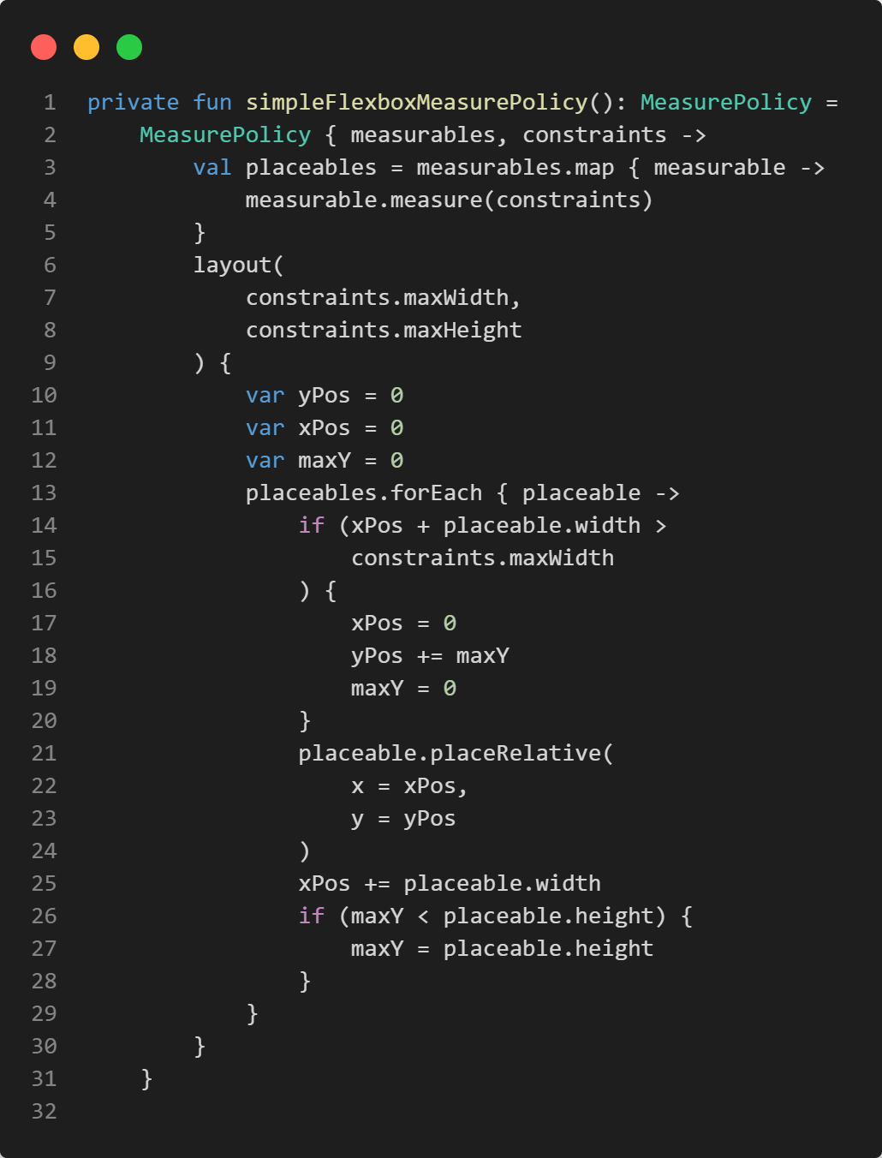
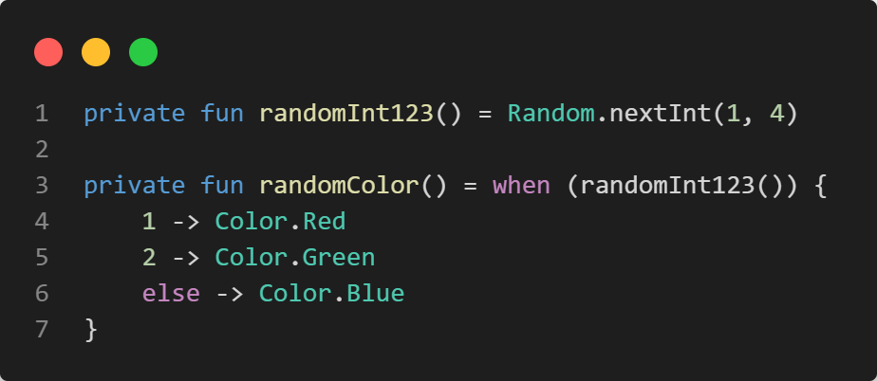

Slide 8
Animations
Have become very important
Not easy to achieve using Views
But seamlessly integrated into Jetpack Compose

Slide 9
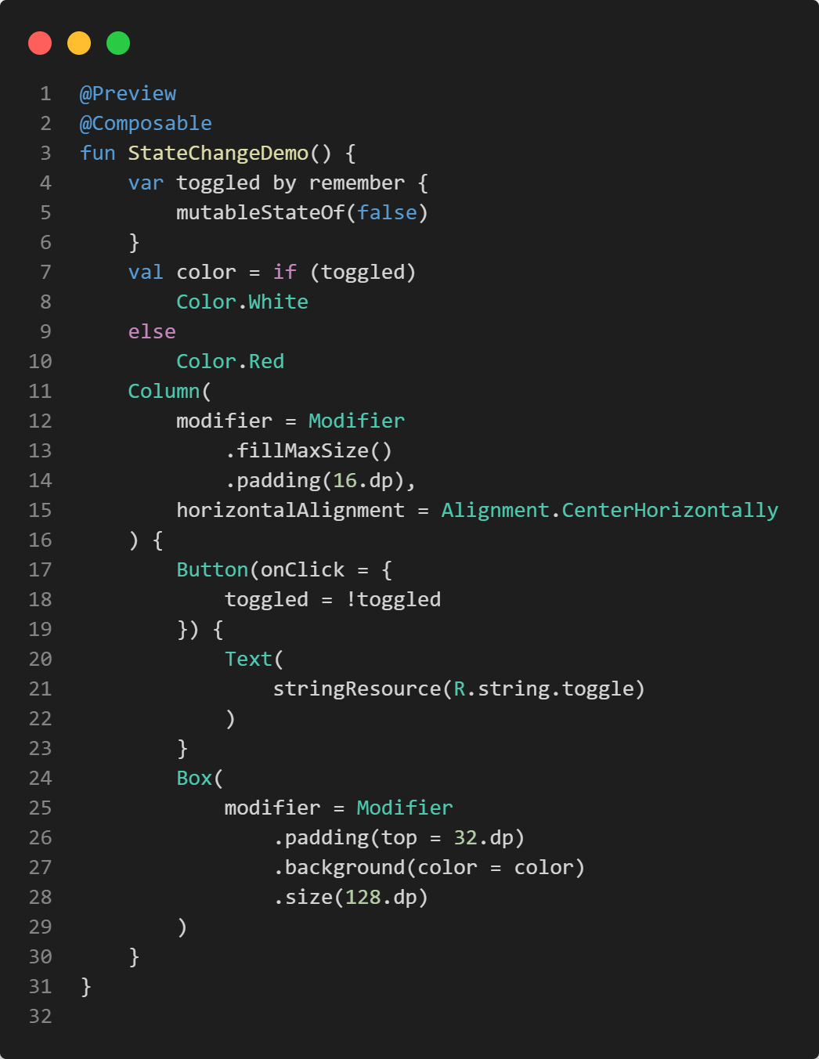
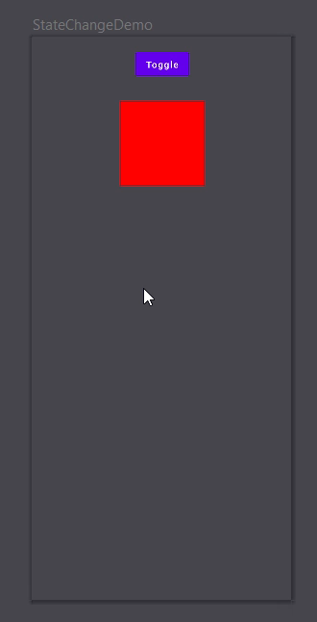

Slide 10
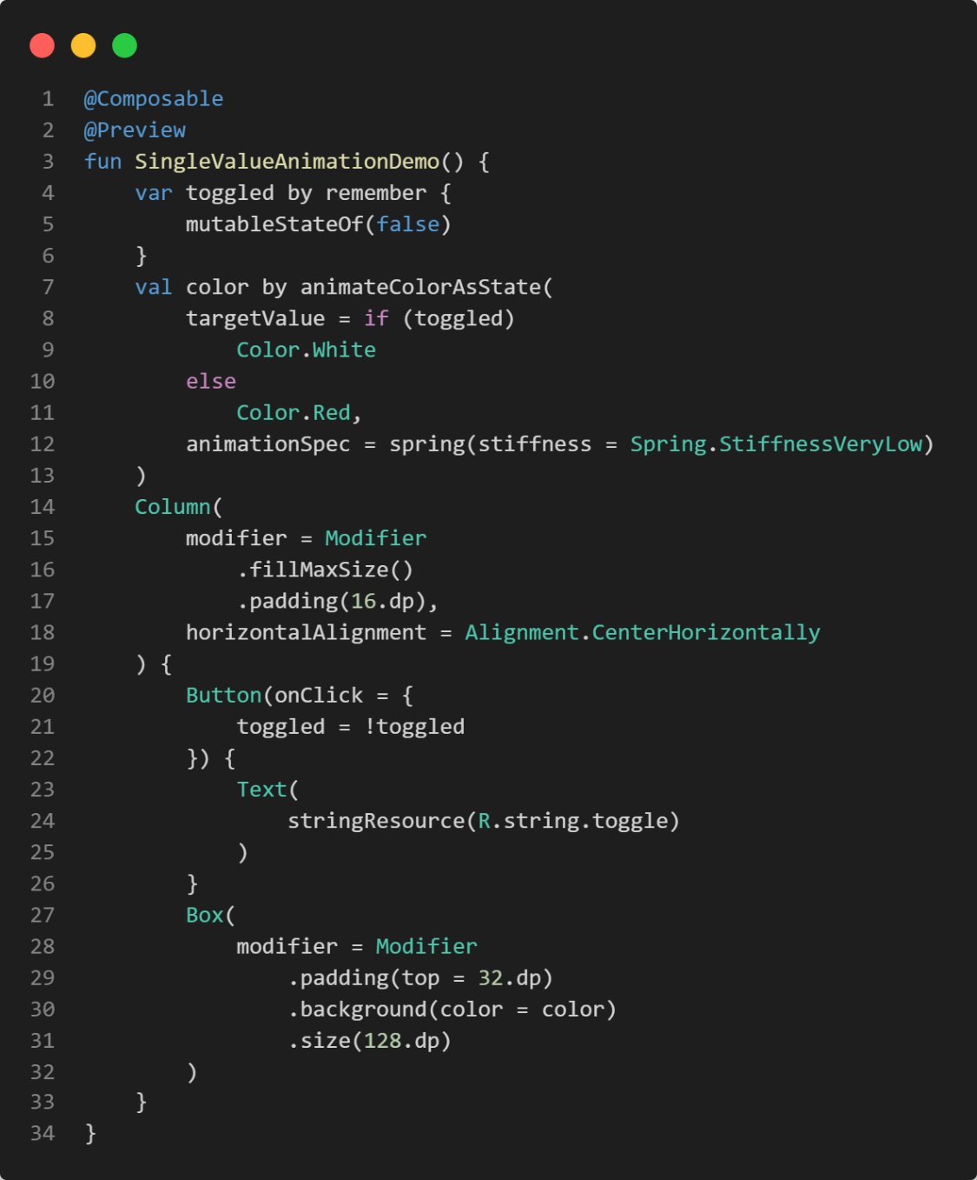
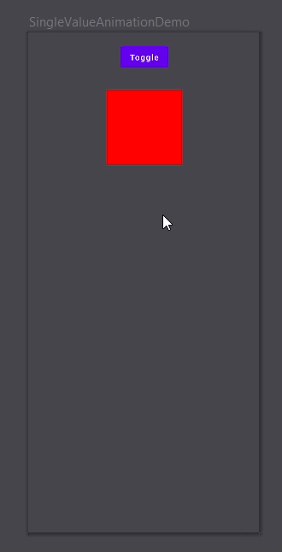

Slide 11
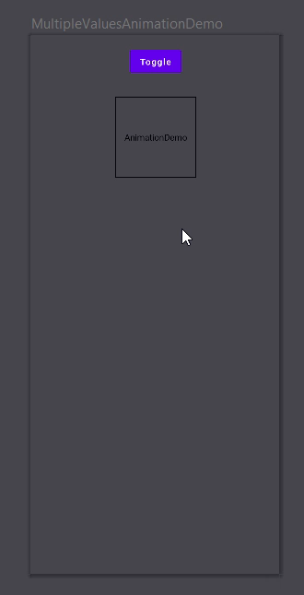

Slide 12
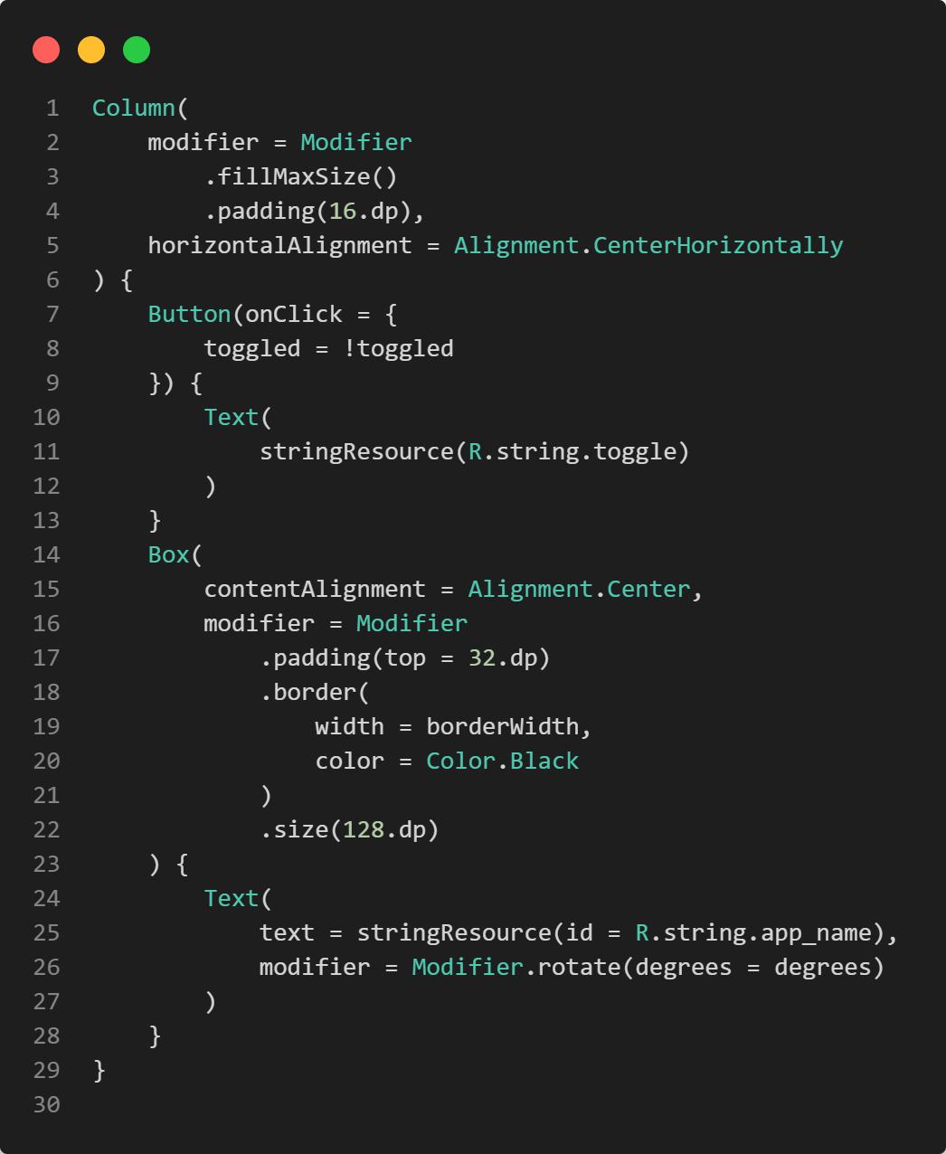

Slide 13
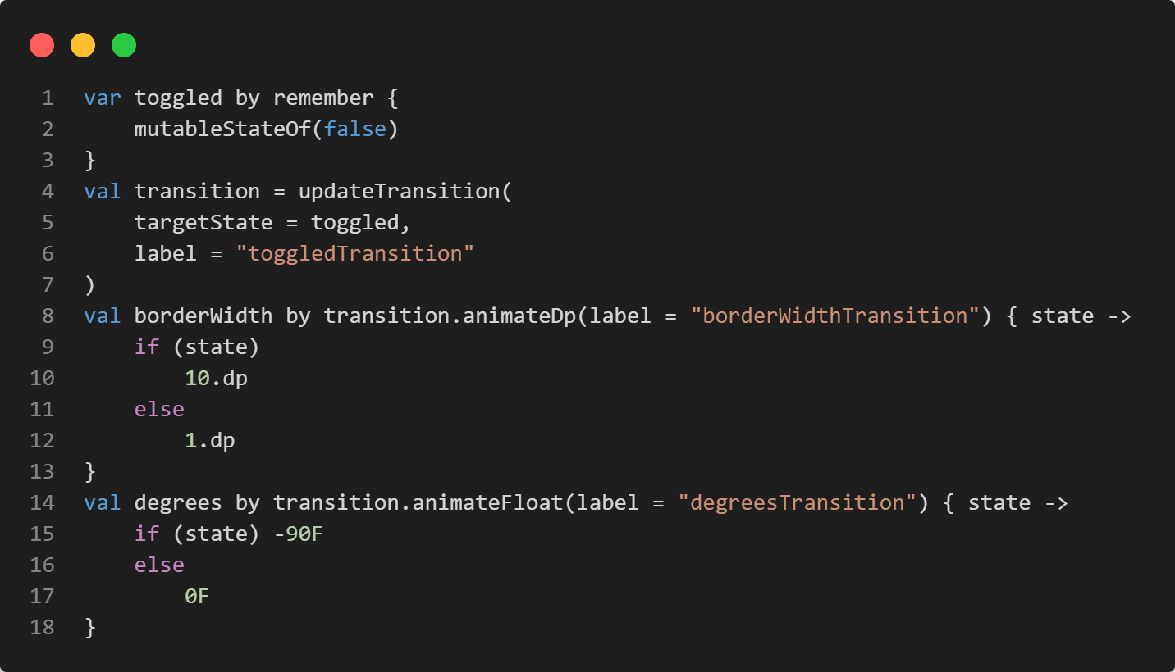

Slide 14
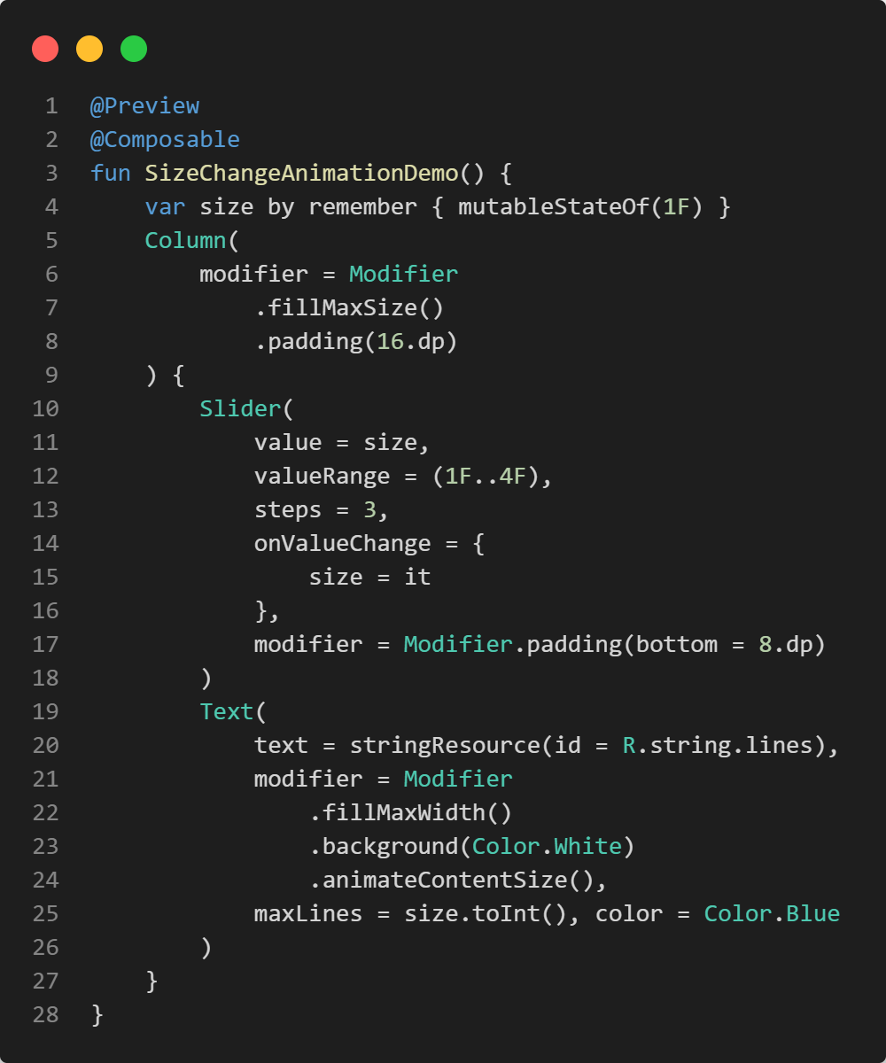
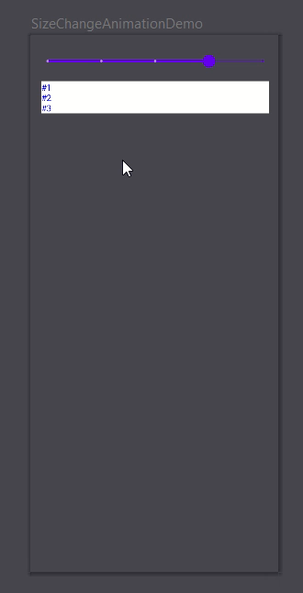

Slide 15
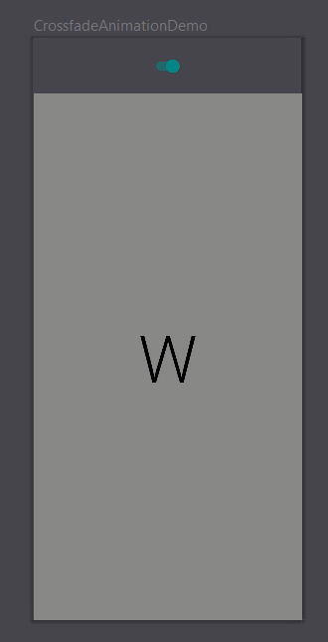

Slide 16
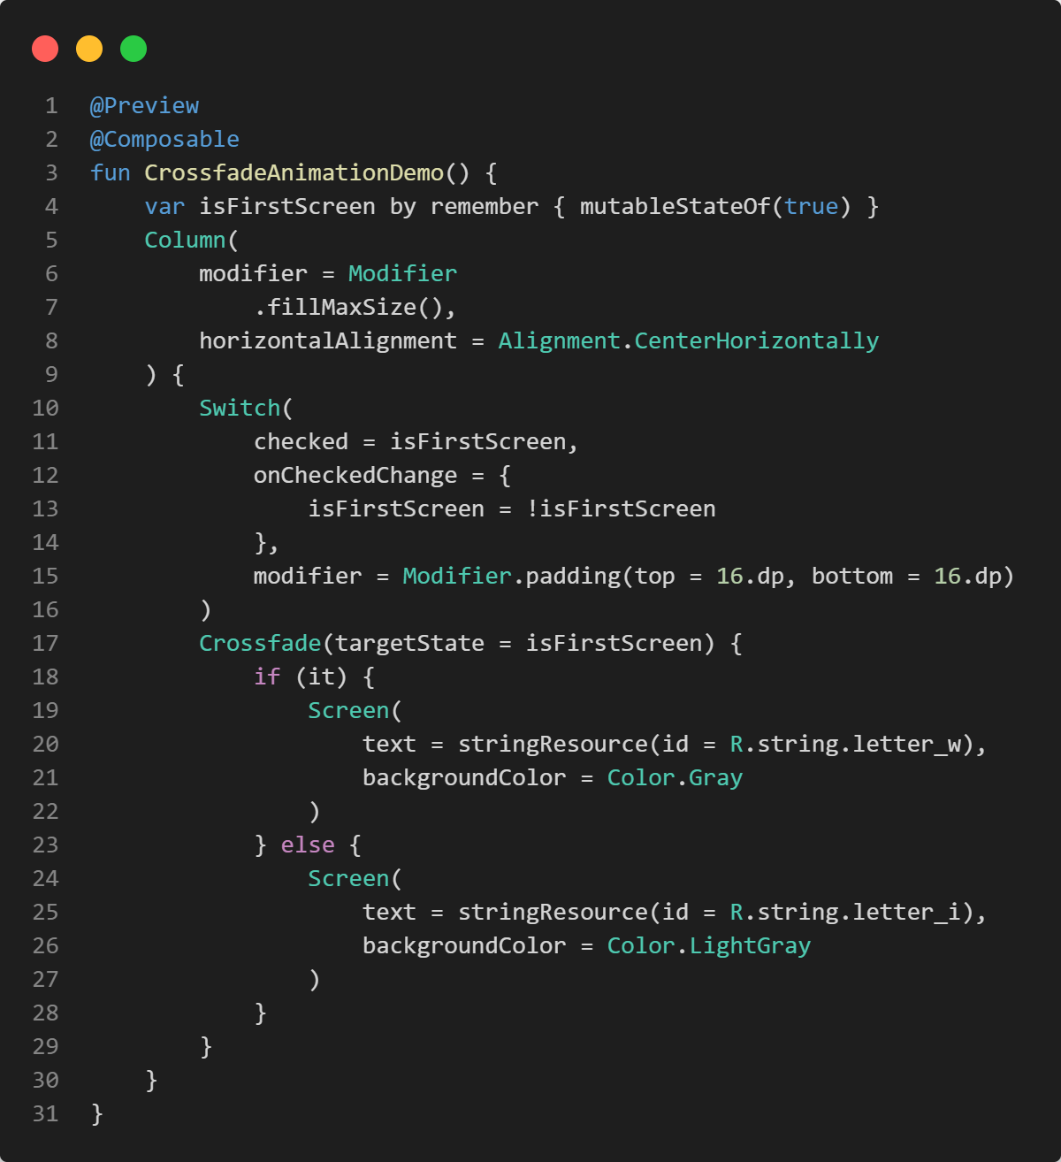
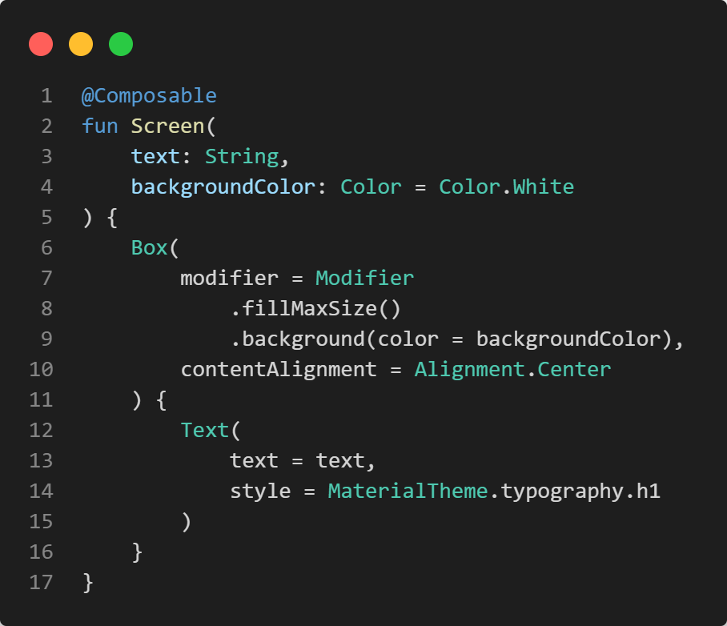

Slide 17
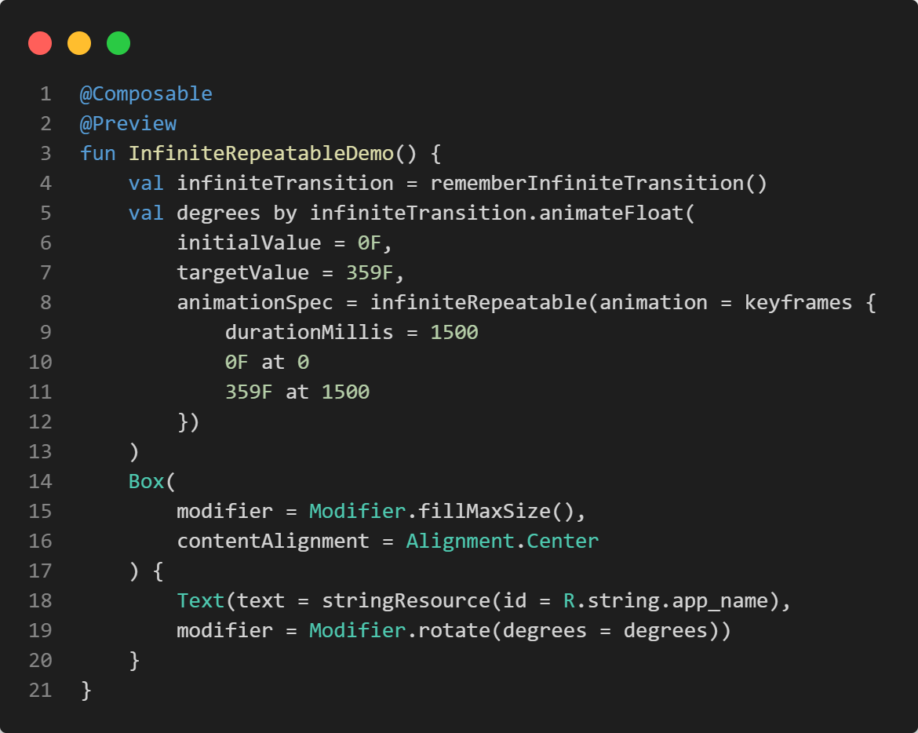
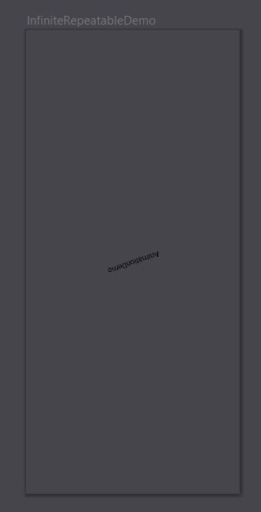

Slide 18
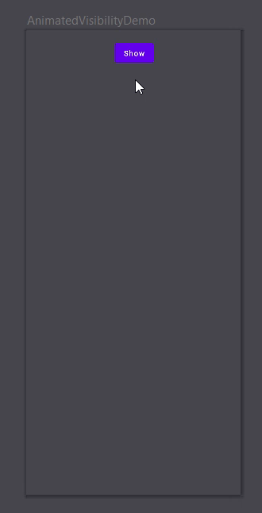
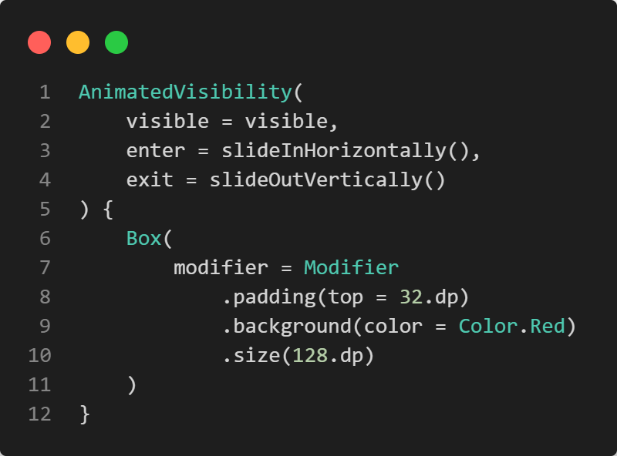

Slide 19

Exercise
https://unsplash.com/photos/IZOAOjvwhaM

Slide 20
Animate 😎
Familiarize yourself with animations by looking at AnimationDemo
Spice up CounterDemoCompose by adding some animations, for example
continuously rotating the counter
crossfading the counter

Slide 21

Further reading
Chapter 8: Working with Animations
free PDF

Slide 22

Questions…?
Short break… 😍

